Slide 1


Social Buzz Analysis

Slide 2


Today's agenda
Project recap
Problem
The Analytics team
Process
Insights
Summary

Slide 3

Social Buzz, a rapidly growing technology unicorn, needs to adapt quickly to its global scale. Accenture has begun a three-month proof of concept (POC) focusing on several key tasks to support Social Buzz’s continued growth and upcoming IPO.
Audit of Social Buzz’s big data practice
Recommendations for a successful IPO
Analysis of Social Buzz’s top 5 most popular content categories
Project Recap

Slide 4

Problem
Over 100000 posts per day
36,500,000 pieces of content per year!
But how to Capitalize on it when there is so much?
Analysis to find Social Buzz’s top 5 most popular categories of content

Slide 5



ANDREW FLEMING
Chief Technology Architect
The Analytics team
MARCUS ROMPTON
Senior Principal
Anika Saxena
Data Analyst

Slide 6
Process
1
Data Understanding
2
Data Cleaning
3
Data Modelling
4
Data Analysis
5
Uncover Insights

Slide 7

Insights
16
Unique Categories
1897
Reactions to “Animal” posts
May
Month with
most posts

Slide 8
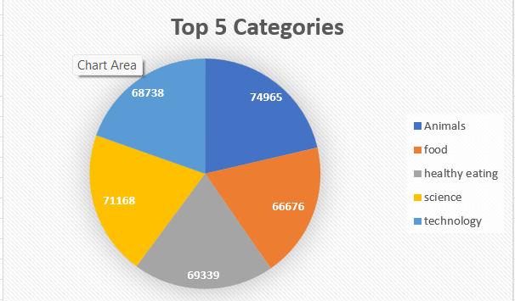
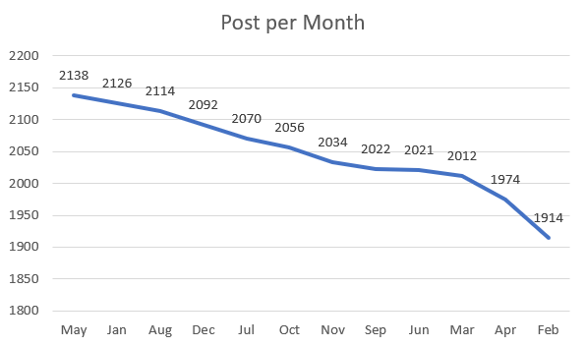

Slide 9
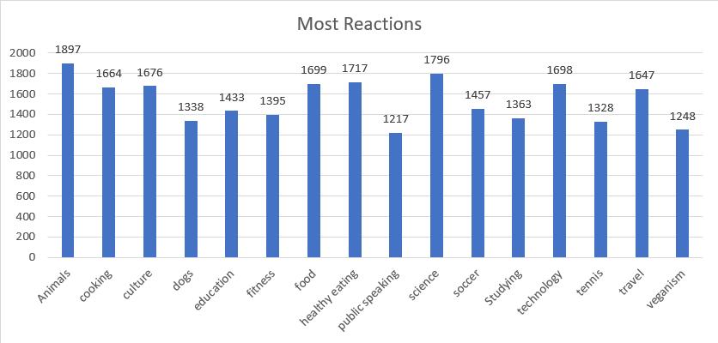

Slide 10

ANALYSIS
Animal and Science are the most popular categories of content showing that people enjoy “real-life” and “factual” content the most.
INSIGHT
Top content categories: Animals, Science, Healthy Eating, Food, and Cooking with Animal ranking the highest. Focus on these for high engagement; include Technology and Culture for diversity
Summary
NEXT STEPS
This ad-hoc analysis is insightful, but it’s time to take this analysis into large scale production for real-time understanding of your business. We can show you how to do this.

Slide 11
Thank you!
ANY QUESTIONS?

